Slide 1
Infants Parent’s Information

Slide 2


Our Classes
OWL CLASS
HAWK CLASS

Slide 3
STAFFING
MRS WEST Mrs Milverton Mrs GRAfton
Mrs moore Mrs mayhew-sanders miss bRunt

Slide 4
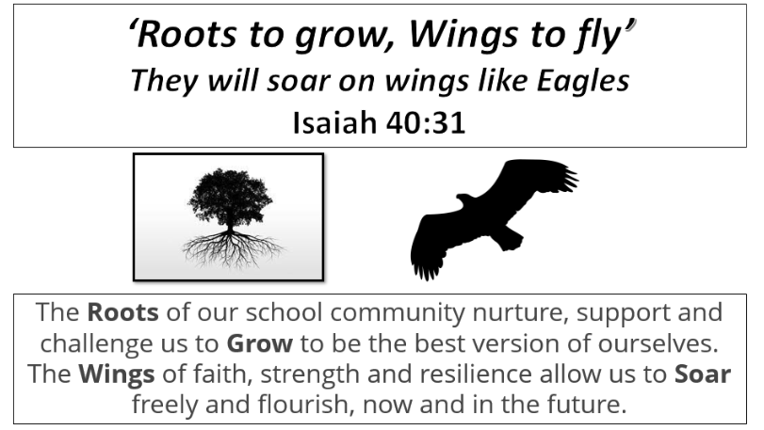
St Andrew’s vision

Slide 5
A day at st Andrew’s
Arrival
Early morning work
Register
Phonics/spelling
Guided reading
English
Worship
Break
Maths
Lunch/break
Session 1
Session 2
Dear time
Home time

Slide 6

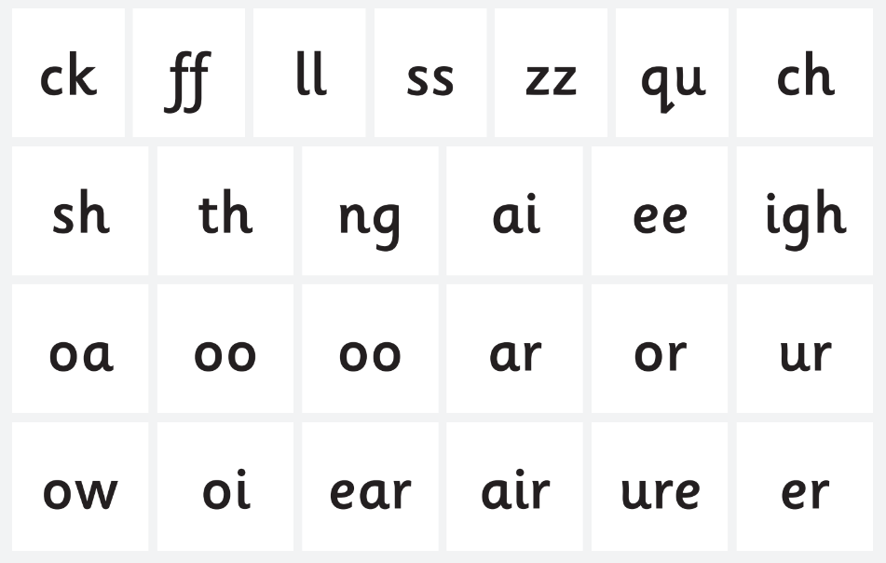
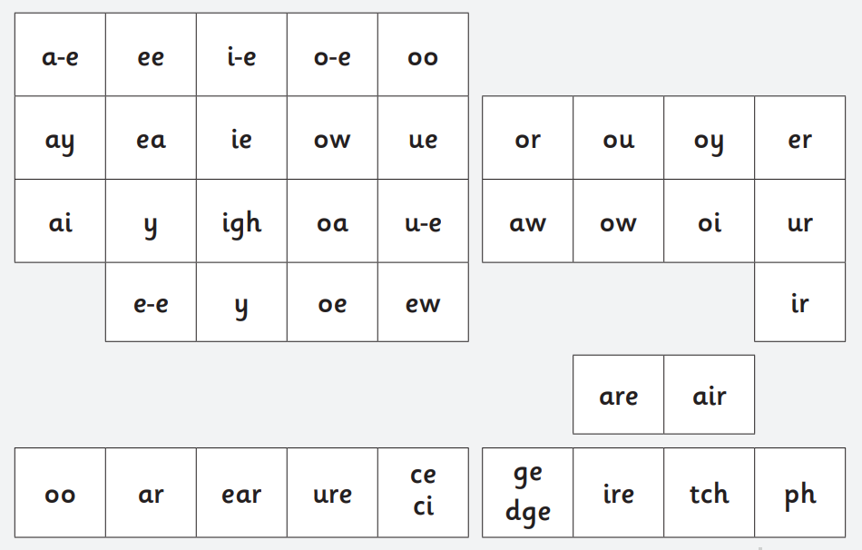
YR and Y1 phonics

Slide 7

How can I support children with blending?
The ability to blend phonemes into words orally (oral blending) is a vital skill for reading. To help children who are struggling with this skill, children may need extra practice with oral blending throughout the school day; this could be through giving classroom instructions in a segmented way e.g. 'We are going to s-i-t on the carpet.' It may be also useful in EYFS to play games such as I Spy e.g. 'I spy something spelt 'h-a-t' and then have children point out the object.

Slide 8
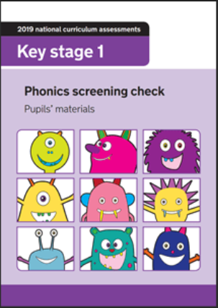
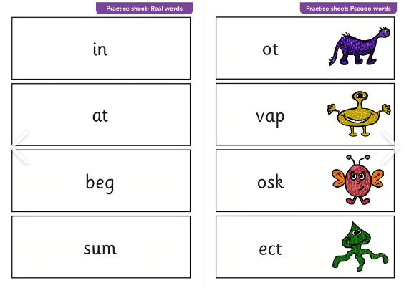
Y1 Phonics screening

Slide 9
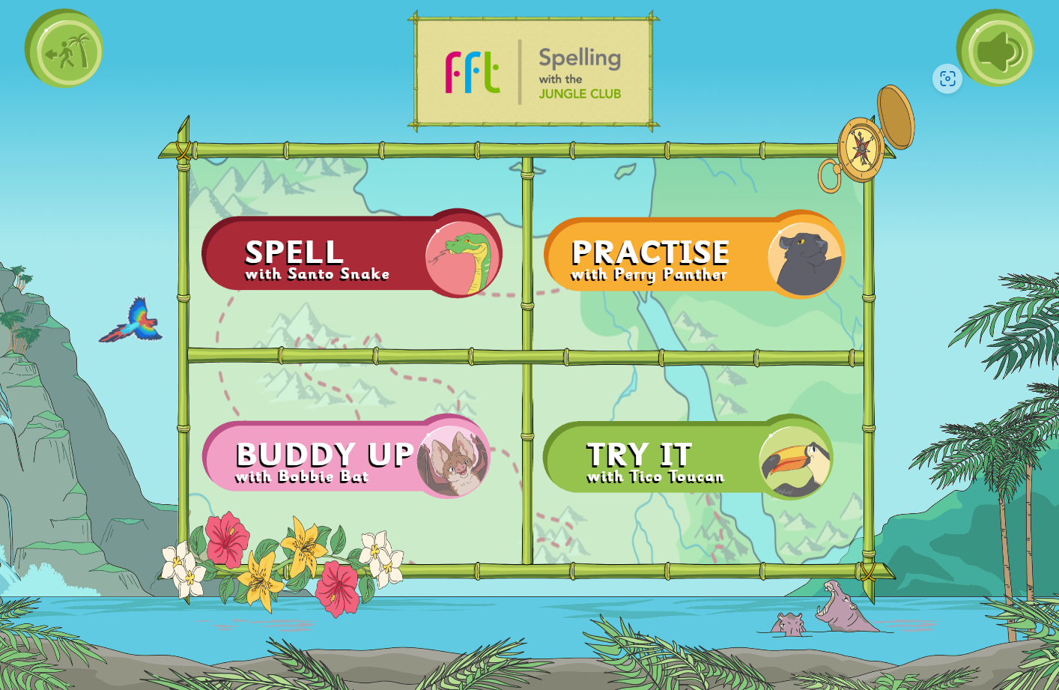
Y2 Spelling

Slide 10
Reading
Reception
FFT Reading book to practice phoneme learnt that week
YEAR 1
FFT Reading book and Bug club matched to child’s phonics level
Year 2
Bug club or code x dependent on phonics level
*books are changed once a week on fridays

Slide 11
Home learning
Reading (x5 weekly)
Spellings – Y2 (weekly)
TTRS – Y2 (Y1 summer Term)
*Star reader friday

Slide 12
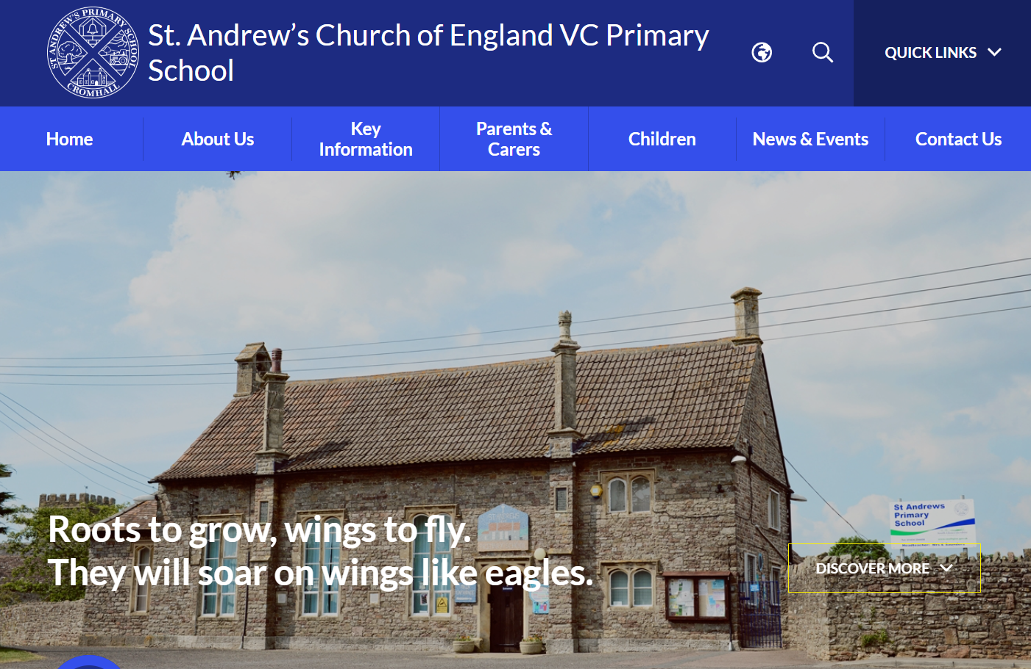
School website

Slide 13
Thank you for joining us this afternoon!

